Slide 1
Unit-4
MACHINE LEARNING: 6 Hours
Introduction to machine learning – definition, terminology. Types of machine learning – supervised learning, unsupervised learning, semi-supervised learning, reinforcement learning. Machine learning process. Performance metric in machine learning. Tools and frameworks.
Machine Learning | What Is Machine Learning? | Introduction To Machine Learning | 2024 | Simplilearn
Machine Learning Tutorial | Machine Learning Basics | Machine Learning Algorithms | Simplilearn - YouTube

Slide 2
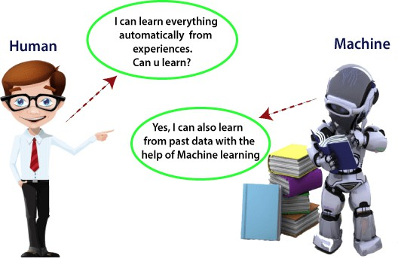
What is Machine Learning
What is Machine Learning?
Definition:
Machine Learning (ML) is a subset of
data and past experiences without explicit programming.
The term "machine learning" was first introduced by Arthur Samuel in 1959.
Artificial | Intelligence | (AI) | that
enables | computers to | learn | from

Slide 3
Key Concepts of Machine Learning
Automatic Learning from Data:
Machines learn and improve from data automatically.
Predictive Modeling:
Algorithms create models to predict based on historical data.
Integration of Fields:
Combines statistics and computer science for model building.
Learning and Performance:
Effectiveness increases with more data exposure.

Slide 4
How Machine Learning Works
Data Collection:
Gather historical data for training.
Algorithm Development:
Analyze data to identify patterns.
Model Training:
Fine-tune the model using training data.
Prediction and Decision Making:
Make predictions based on new, unseen data.
Improvement:
Continuous learning from new data enhances accuracy.

Slide 5
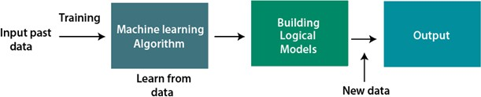

Slide 6
Machine learning involves a specialized vocabulary. Key terms include:
Algorithm:
A set of rules or instructions used by a machine learning model to process data and make predictions or decisions. Examples include Linear Regression, Decision Trees, and Neural Networks.
Model:
The output of a machine learning algorithm after training on data. It encapsulates the learned patterns and relationships, enabling it to make predictions on new, unseen data.
Features:
The input variables or characteristics of the data used to train a model and make predictions. These can be numerical or categorical.
Labels:
In supervised learning, the target variable or the outcome that the model is trained to predict. Each set of features is associated with a corresponding label in the training data.
Training Data:
The dataset used to teach the machine learning model. The model learns patterns and relationships from this data.
Test Data:
A separate dataset used to evaluate the performance of a trained model on unseen data, providing an indication of its generalization ability.
Validation Set:
A subset of data used during the training process to tune hyperparameters and prevent overfitting.
Hyperparameters:
Configuration settings of a machine learning model that are set before training begins and are not learned from the data. Examples include learning rate, batch size, and the number of layers in a neural network.
Overfitting:
A phenomenon where a model learns the training data too well, including noise and outliers, leading to poor performance on new data.

Slide 7
Underfitting:
Occurs when a model is too simple to capture the underlying patterns in the data, resulting in poor performance on both training and new data.
Loss Function:
A function that quantifies the error or discrepancy between the model's predictions and the actual labels. The goal of training is to minimize this loss.
Optimization Algorithm:
A method used to adjust the model's parameters to minimize the loss function during training. Gradient Descent is a common example.
Epoch:
One complete pass through the entire training dataset during the training process.
Batch Size:
The number of training samples processed before the model's parameters are updated by the optimization algorithm.

Slide 8
Supervised Learning:
A type of machine learning where the model learns from labeled data to make predictions or classifications.
Unsupervised Learning:
A type of machine learning where the model learns patterns and structures from unlabeled data, often used for clustering or dimensionality reduction.
Reinforcement Learning:
A type of machine learning where an agent learns to make decisions by interacting with an environment and receiving rewards or penalties.
Deep Learning:
A subfield of machine learning that utilizes artificial neural networks with multiple layers (deep neural networks) to learn complex representations from data.

Slide 9
MACHINE LEARNING TERMINOLOGY
Machine Learning Relationships
Machine learning systems uses Relationships between Inputs to produce Predictions.
In algebra, a relationship is often written as y = ax + b:
y is the label we want to predict
a is the slope of the line
x are the input values
b is the intercept
With ML, a relationship is written as y = b + wx:
y is the label we want to predict
w is the weight (the slope)
x are the features (input values)
b is the intercept

Slide 10

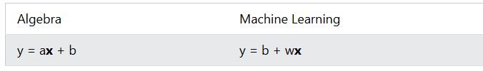
Machine Learning Labels
In Machine Learning terminology, the label is the thing we want to predict.
It is like the y in a linear graph:
Machine Learning Features
In Machine Learning terminology, the features are the input.
They are like the x values in a linear graph:
Sometimes there can be many features (input values) with different weights:
y = b + w₁x₁ + w₂x₂ + w₃x₃ + w₄x₄

Slide 11
Machine Learning Model
A Model defines the relationship between the label (y) and the features (x).
There are three phases in the life of a model:
Data Collection
Training
Inference
Machine Learning Training
The goal of training is to create a model that can answer a question. Like what is the expected price for a house?
Machine Learning inference
Inference is when the trained model is used to infer (predict) values using live data. Like putting the model into production.

Slide 12
Phases of Machine Learning
Machine learning has two main phases:
1. Training: Input data are used to calculate the parameters of the model.
2. Inference: The "trained" model outputs correct data from any input.

Slide 13
Supervised Machine Learning
Supervised Machine Learning uses a set of input variables to predict the value of an output variable.
Supervised learning uses labeled data (data with known answers) to train algorithms to:
Classify Data
Predict Outcomes
Supervised learning can classify data like "What is spam in an e-mail", based on known spam examples.
Supervised learning can predict outcomes like predicting what kind of video you like, based on the videos you have played.

Slide 14
Unsupervised Machine Learning
Unsupervised Machine Learning uses patterns from any unlabeled dataset, trying to understand patterns (or groupings) in the data.
Unsupervised learning is used to predict undefined relationships like meaningful patterns in data.
It is about creating computer algorithms than can improve themselves.
It is expected that machine learning will shift to unsupervised learning to allow programmers to solve problems without creating models.

Slide 15
Reinforcement Learning
Reinforcement learning is based on non-supervised learning but receives feedback from the user whether the decision is good or bad.
The feedback contributes to improving the model.
Self Supervised Learning
Self-supervised learning is similar to unsupervised learning because it works with data without human added labels.
The difference is that unsupervised learning uses clustering, grouping, and dimensionality reduction, while self-supervised learning draw its own conclusions for regression and classification tasks.

Slide 16
Features of Machine Learning
Pattern Detection
Definition:
ML utilizes data to detect patterns within datasets.
Benefits:
Identifies trends, relationships, and anomalies that may not be immediately obvious.
Automatic Learning and Improvement
Capability:
Algorithms learn from past data and improve performance over time.
Impact:
Refinement of predictions and decisions as more data becomes available.

Slide 17
Data-Driven Technology
Core Concept:
ML is fundamentally data-driven.
Reliance:
Effectiveness and accuracy depend heavily on data quality and quantity.
Similarity to Data Mining
Comparison:
Shares similarities with data mining (analyzing large datasets).
Focus:
Data mining discovers unknown patterns; ML uses patterns for predictions and performance improvement.

Slide 18
Need for Machine Learning
Complex Task Automation
Demand:
Handles tasks too complex for manual implementation.
Advantage:
Processes vast amounts of data efficiently, overcoming human limitations.
Data Handling Capabilities
Human Limitations:
Manual access and analysis of enormous datasets is impractical.
ML Advantage:
Automatically explores, analyzes, and builds models from large volumes of data.

Slide 19
Cost and Time Efficiency
Benefits:
Saves time and money through automation.
Outcome:
Reduces need for manual intervention, enhancing operational efficiency.
Real-World Applications
Examples:
Self-Driving Vehicles: Interpreting sensor data for driving decisions.
Digital Fraud Detection: Identifying unusual patterns in transactions.
Face Recognition: Enhancing security via facial recognition.
Recommendation Systems: Platforms like Netflix and Amazon personalize suggestions.

Slide 20
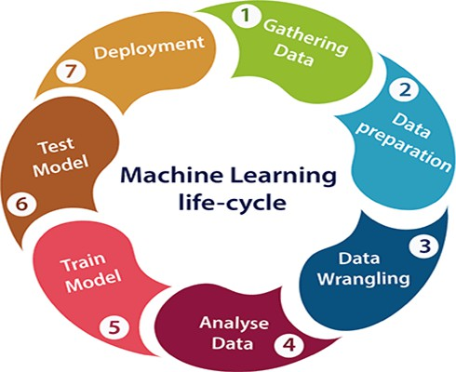
Machine learning Life cycle

Slide 21
1. Gathering Data
Objective:
Identify and obtain data from various sources.
Tasks:
Identify Various Data Sources:
Files, databases, internet, mobile devices.
Collect Data:
Accumulate data from identified sources.
Integrate Data:
Combine data to create a unified dataset.
Importance:
Quality and quantity of data impact model efficiency and accuracy.

Slide 22
2. Data Preparation
Objective:
Organize and format collected data for training.
Processes:
Data Exploration:
Understand characteristics, format, and quality.
Data Pre-processing:
Clean and format data.
Key Steps:
Consolidate and randomize data for a representative dataset.

Slide 23
3. Data Wrangling
Objective:
Clean and convert raw data into a usable format.
Tasks:
Cleaning Data:
Address missing values, duplicates, invalid data.
Selecting Variables:
Choose relevant variables for analysis.
Transforming Data:
Properly format data for further analysis.
Importance:
Affects quality and effectiveness of analysis, improving model accuracy.

Slide 24
4. Data Analysis
Objective:
Analyze cleaned data to build a machine learning model.
Tasks:
Selection of Analytical Techniques:
Choose methods (Classification, Regression, Clustering).
Building Models:
Construct models using prepared data.
Reviewing Results:
Evaluate and adjust model performance.
Aim:
Build a model that effectively analyzes data and solves the problem.

Slide 25
5. Train Model
Objective:
Enhance model performance through training.
Tasks:
Use datasets to train with various machine learning algorithms.
Enable the model to learn patterns and rules.
Importance:
Essential for understanding and predicting outcomes.

Slide 26
6. Test Model
Objective:
Evaluate accuracy and performance of the trained model.
Tasks:
Provide a test dataset.
Measure accuracy to ensure project requirements are met.
Importance:
Verifies model effectiveness and allows for fine-tuning.

Slide 27
7. Deployment
Objective:
Deploy the trained model in a real-world system.
Tasks:
Implement in a production environment.
Ensure model accuracy and efficiency.
Importance:
Final step, integrating the model into operational systems for practical use.

Slide 28
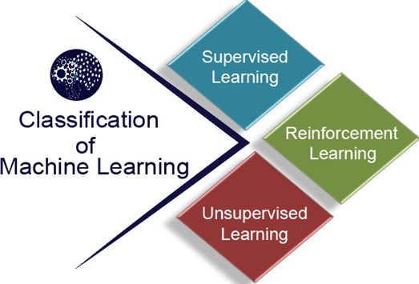

Slide 29
SUPERVISED MACHINE LEARNING
Supervised learning is a type of machine learning where a model learns from labelled data—meaning every input has a corresponding correct output.
The model makes predictions and compares them with the true outputs, adjusting itself to reduce errors and improve accuracy over time.
The goal is to make accurate predictions on new, unseen data.
For example, a model trained on images of handwritten digits can recognise new digits it has never seen before.

Slide 30
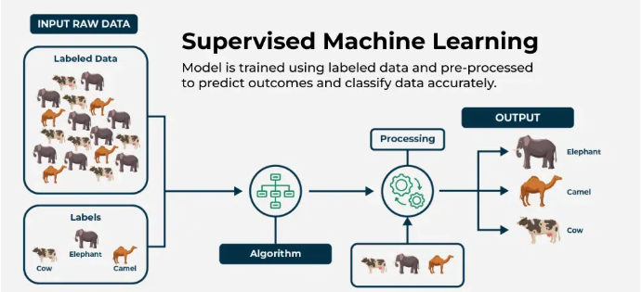

Slide 31
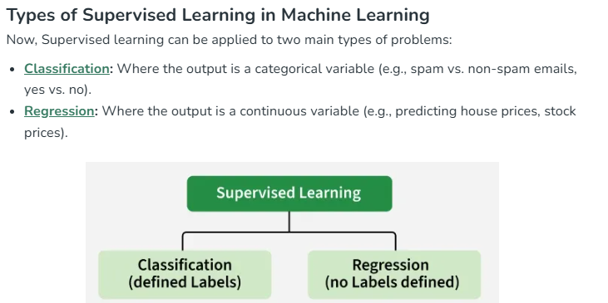

Slide 32
While training the model, data is usually split in the ratio of 80:20 i.e. 80% as training data and the rest as testing data.
In training data, we feed input as well as output for 80% of data.
The model learns from training data only.
We use different supervised learning algorithms (which we will discuss in detail in the next section) to build our model.

Slide 33
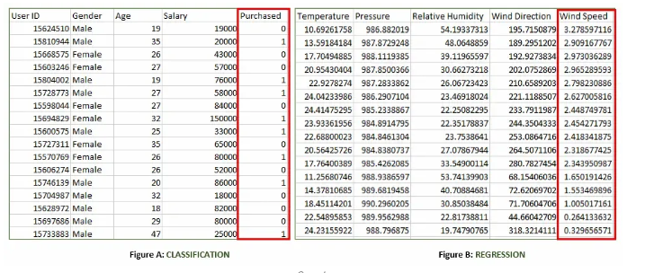
Let's first understand the classification and regression data through the table below:

Slide 34
Both the above figures have labelled data set as follows:
Figure A: It is a dataset of a shopping store that is useful in predicting whether a customer will purchase a particular product under consideration or not based on his/her gender, age and salary.
Input: Gender, Age, Salary
Output: Purchased i.e. 0 or 1; 1 means yes the customer will purchase and 0 means that the customer won't purchase it.
Figure B: It is a Meteorological dataset that serves the purpose of predicting wind speed based on different parameters.
Input: Dew Point, Temperature, Pressure, Relative Humidity, Wind Direction
Output: Wind Speed

Slide 35
Working of Supervised Machine Learning
1. Collect Labeled Data
Gather a dataset where each input has a known correct output (label).
Example: Images of handwritten digits with their actual numbers as labels.
2. Split the Dataset
Divide the data into training data (about 80%) and testing data (about 20%).
The model will learn from the training data and be evaluated on the testing data.

Slide 36
3. Train the Model
Feed the training data (inputs and their labels) to a suitable supervised learning algorithm (like Decision Trees, SVM or Linear Regression).
The model tries to find patterns that map inputs to correct outputs.
4. Validate and Test the Model
Evaluate the model using testing data it has never seen before.
The model predicts outputs and these predictions are compared with the actual labels to calculate accuracy or error.
5. Deploy and Predict on New Data
Once the model performs well, it can be used to predict outputs for completely new, unseen data.

Slide 37
Supervised Machine Learning Algorithms
Here are some of the most common types of supervised learning algorithms:
Linear Regression: Linear regression is a type of supervised learning regression algorithm that is used to predict a continuous output value. It is one of the simplest and most widely used algorithms in supervised learning.
Logistic Regression: Logistic regression is a type of supervised learning classification algorithm that is used to predict a binary output variable.
Decision Trees : Decision tree is a tree-like structure that is used to model decisions and their possible consequences. Each internal node in the tree represents a decision, while each leaf node represents a possible outcome.

Slide 38
Random Forests: Random forests again are made up of multiple decision trees that work together to make predictions. Each tree in the forest is trained on a different subset of the input features and data. The final prediction is made by aggregating the predictions of all the trees in the forest. Support Vector Machine(SVM): The SVM algorithm creates a hyperplane to segregate n-dimensional space into classes and identify the correct category of new data points. The extreme cases that help create the hyperplane are called support vectors, hence the name Support Vector Machine.
K-Nearest Neighbors: KNN works by finding k training examples closest to a given input and then predicts the class or value based on the majority class or average value of these neighbors. The performance of KNN can be influenced by the choice of k and the distance metric used to measure proximity.

Slide 39
Gradient Boosting: Gradient Boosting combines weak learners, like decision trees, to create a strong model. It iteratively builds new models that correct errors made by previous ones.
Naive Bayes Algorithm: The Naive Bayes algorithm is a supervised machine learning algorithm based on applying Bayes' Theorem with the “naive” assumption that features are independent of each other given the class label.

Slide 40
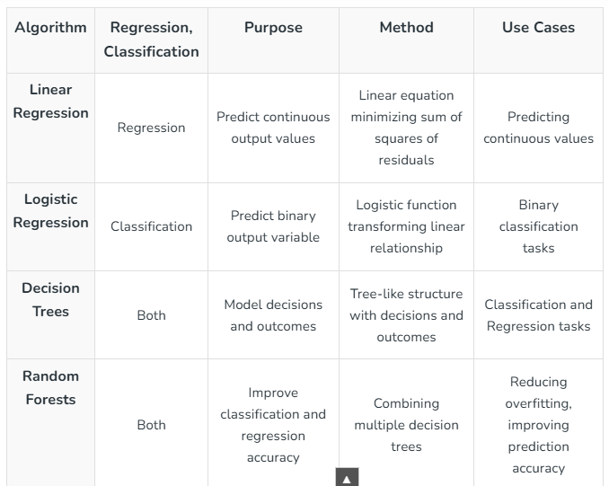

Slide 41
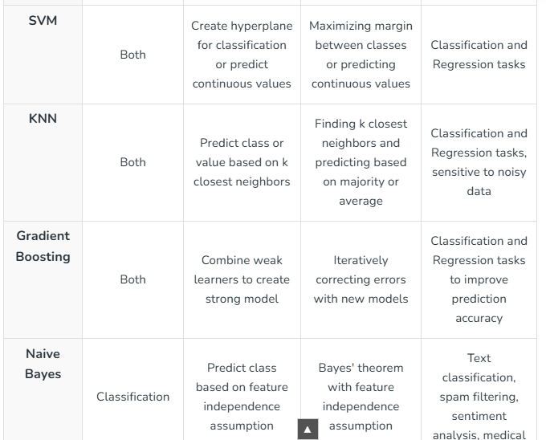

Slide 42
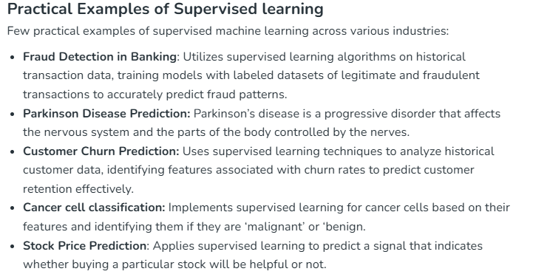

Slide 43
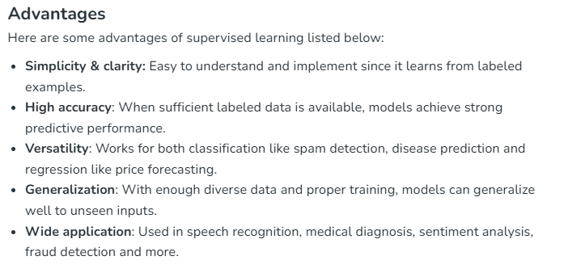

Slide 44
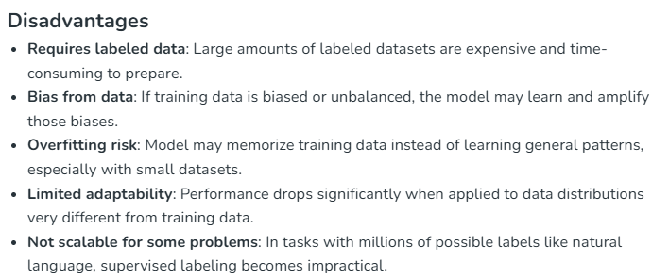

Slide 45
UNSUPERVISED MACHINE LEARNING
Unsupervised learning is a type of machine learning that analyzes and models data without labelled responses or predefined categories.
Unlike supervised learning, where the algorithm learns from input-output pairs, unsupervised learning algorithms work solely with input data and aim to discover hidden patterns, structures or relationships within the dataset independently, without any human intervention or prior knowledge of the data's meaning.

Slide 46
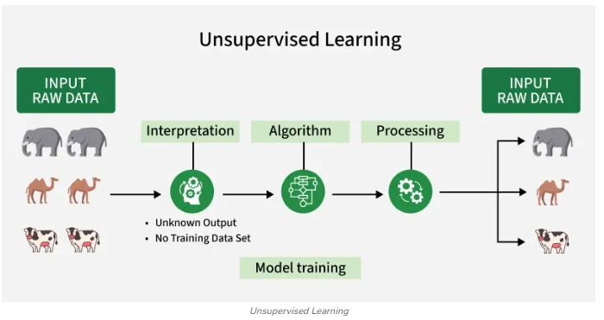

Slide 47
The image shows set of animals like elephants, camels and cows that represents raw data that the unsupervised learning algorithm will process.
The "Interpretation" stage signifies that the algorithm doesn't have predefined labels or categories for the data.
It needs to figure out how to group or organize the data based on inherent patterns.
An algorithm represents unsupervised learning process which can be clustering, dimensionality reduction or anomaly detection to identify patterns in the data.
The processing stage shows the algorithm working on the data.
The output shows the results of the unsupervised learning process.
In this case, the algorithm might have grouped the animals into clusters based on their species (elephants, camels, cows).

Slide 48
WORKING OF UNSUPERVISED MACHINE LEARNING
1. Collect Unlabeled Data
Gather a dataset without predefined labels or categories.
Example: Images of various animals without any tags.
2. Select an Algorithm
Choose a suitable unsupervised algorithm such as clustering like K-Means, association rule learning like Apriori or dimensionality reduction like PCA based on the goal.
3. Train the Model on Raw Data
Feed the entire unlabeled dataset to the algorithm.
The algorithm looks for similarities, relationships or hidden structures within the data. ar animals together or extract key patterns from large datasets.

Slide 49
4. Group or Transform Data
The algorithm organizes data into groups (clusters), rules or lower-dimensional forms without human input.
Example: It may group similar animals together or extract key patterns from large datasets.
5. Interpret and Use Results
Analyze the discovered groups, rules or features to gain insights or use them for further tasks like visualization, anomaly detection or as input for other models.

Slide 50
UNSUPERVISED MACHINE LEARNING ALGORITHMS
There are mainly 3 types of Unsupervised Algorithms that are used:
1. Clustering Algorithms
2. Association Rule Learning
3. Dimensionality Reduction

Slide 51
Clustering Algorithms
It is an unsupervised machine learning technique that groups unlabeled data into clusters based on similarity. Its goal is to discover patterns or relationships within the data without any prior knowledge of categories or labels.
Groups data points that share similar features or characteristics.
Helps find natural groupings in raw, unclassified data.
Commonly used for customer segmentation, anomaly detection and data organization.
Works purely from the input data without any output labels.
Enables understanding of data structure for further analysis or decision-making.

Slide 52
Some common clustering algorithms:
K-means Clustering: Groups data into K clusters based on how close the points are to each other.
Hierarchical Clustering: Creates clusters by building a tree step-by-step, either merging or splitting groups.
Density-Based Clustering (DBSCAN): Finds clusters in dense areas and treats scattered points as noise.
Mean-Shift Clustering: Discovers clusters by moving points toward the most crowded areas.
Spectral Clustering: Groups data by analyzing connections between points using graphs.

Slide 53
Association Rule Learning
It is a rule-based unsupervised learning technique used to discover interesting relationships between variables in large datasets.
It identifies patterns in the form of “if-then” rules, showing how the presence of some items in the data implies the presence of others.
Finds frequent item combinations and the rules connecting them.
Commonly used in market basket analysis to understand product purchase relationships.
Helps retailers design promotions and cross-selling strategies.

Slide 54
Some common Association Rule Learning algorithms:
Apriori Algorithm: Finds patterns by exploring frequent item combinations step-by-step.
FP-Growth Algorithm: An Efficient Alternative to Apriori. It quickly identifies frequent patterns without generating candidate sets.
Eclat Algorithm: Uses intersections of itemsets to efficiently find frequent patterns.
Efficient Tree-based Algorithms: Scales to handle large datasets by organizing data in tree structures.

Slide 55
Dimensionality Reduction
It is the process of decreasing the number of features or variables in a dataset while retaining as much of the original information as possible.
This technique helps simplify complex data making it easier to analyze and visualize. It also improves the efficiency and performance of machine learning algorithms by reducing noise and computational cost.
It reduces the dataset’s feature space from many dimensions to fewer, more meaningful ones.
Helps focus on the most important traits or patterns in the data.
Commonly used to improve model speed and reduce overfitting.

Slide 56
Here are some popular Dimensionality Reduction algorithms:
Principal Component Analysis (PCA): Reduces dimensions by transforming data into uncorrelated principal components.
Linear Discriminant Analysis (LDA): Reduces dimensions while maximizing class separability for classification tasks.
Non-negative Matrix Factorization (NMF): Breaks data into non-negative parts to simplify representation.
Locally Linear Embedding (LLE): Reduces dimensions while preserving the relationships between nearby points.
Isomap: Captures global data structure by preserving distances along a manifold.

Slide 57
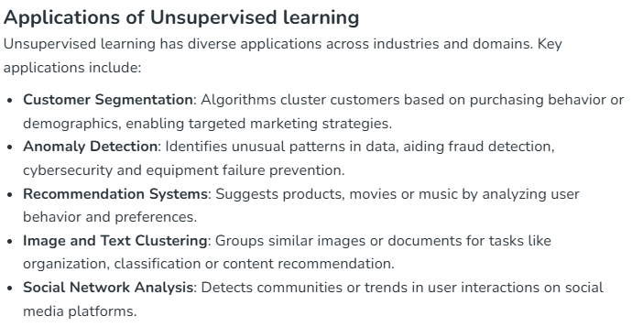

Slide 58
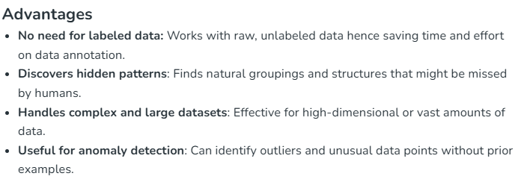

Slide 59
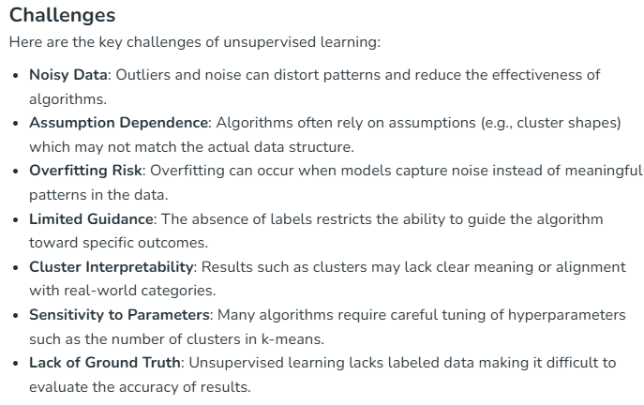

Slide 60
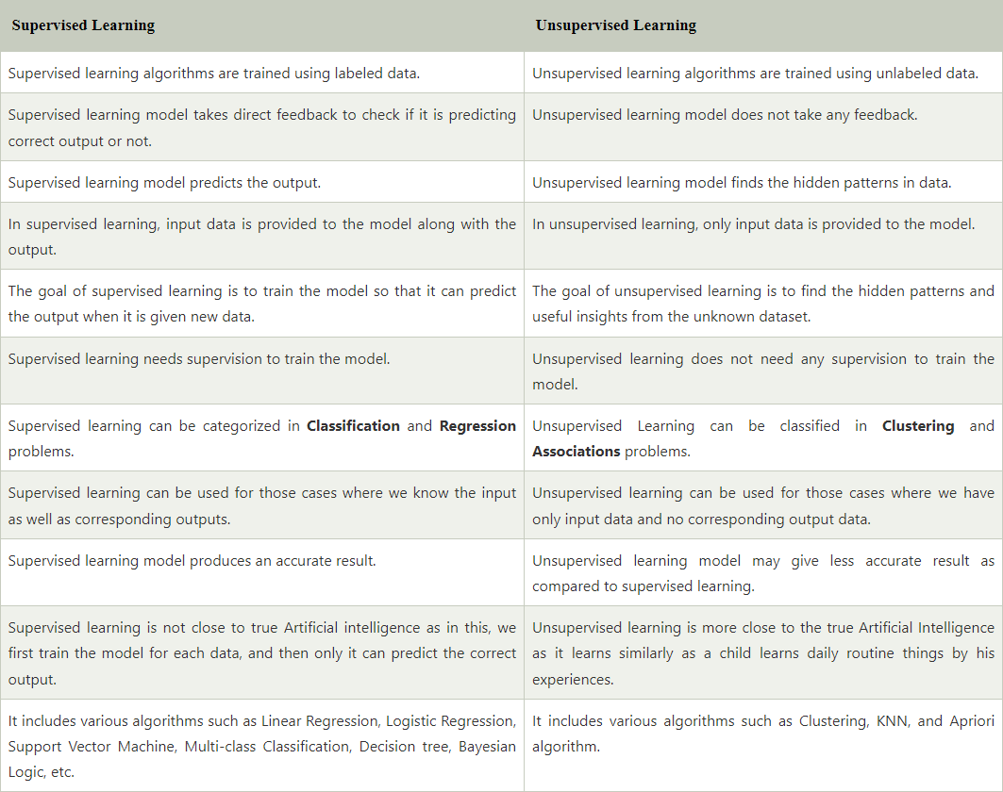

Slide 61
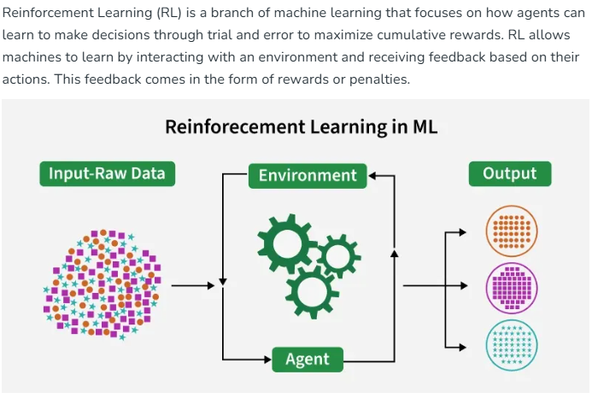
REINFORCEMENT LEARNING

Slide 62
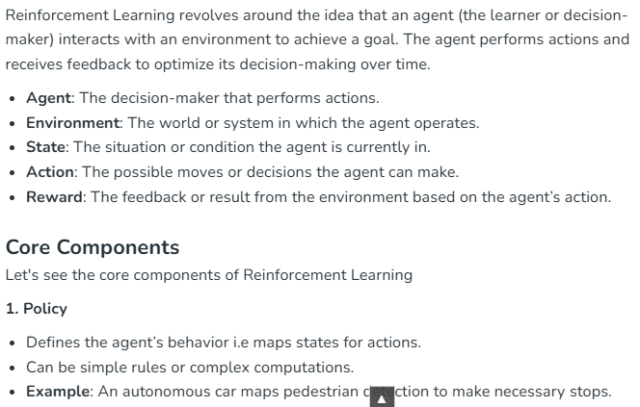

Slide 63
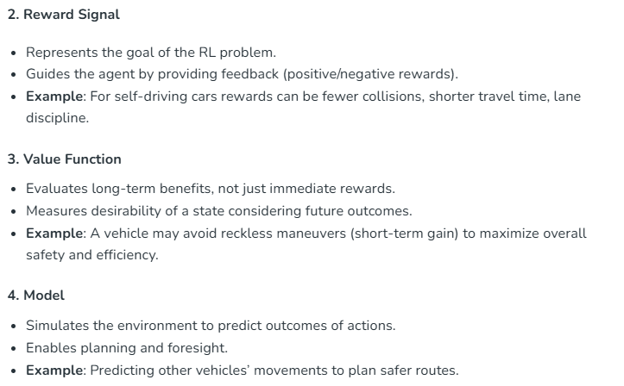

Slide 64
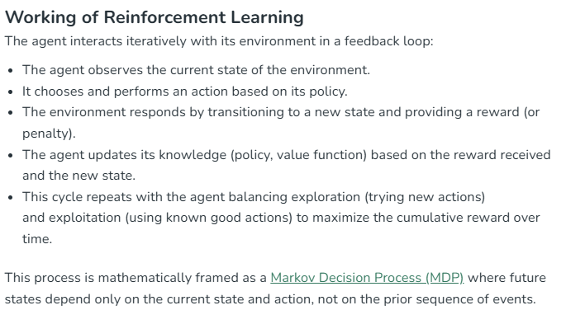

Slide 65
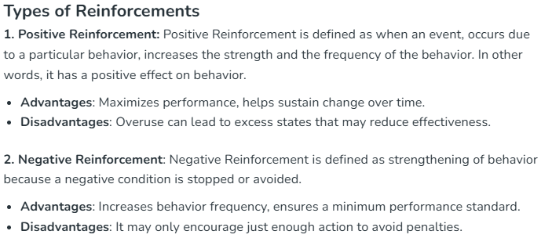

Slide 66
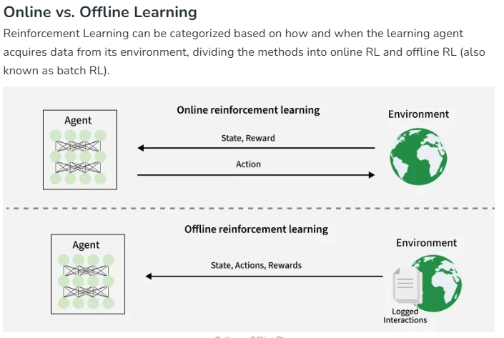

Slide 67
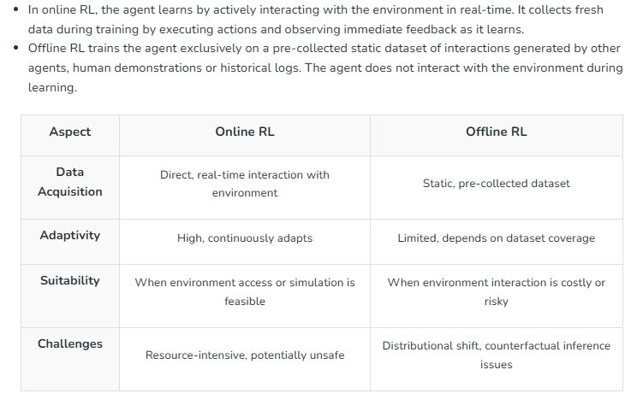

Slide 68
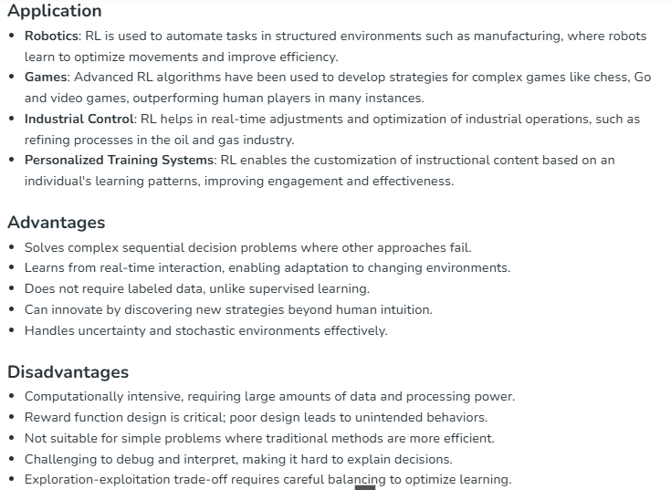

Slide 69
PERFORMANCE METRICS IN MACHINE LEARNING
When building machine learning models, it’s important to understand how well they perform.
Evaluation metrics help us to measure the effectiveness of our models.
Whether we are solving a classification problem, predicting continuous values or clustering data, selecting the right evaluation metric allows us to assess how well the model meets our goals.
We will see commonly used evaluation metrics and discuss how to choose the right metric for our model.
Classification metrics
Regression Metrics
Clustering Metrics

Slide 70
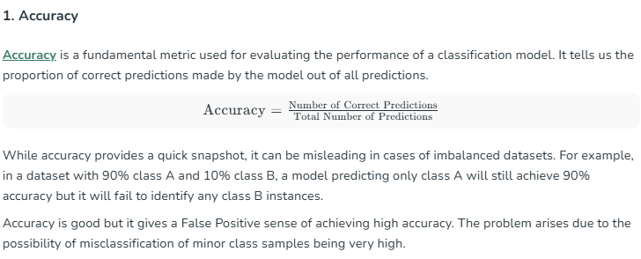
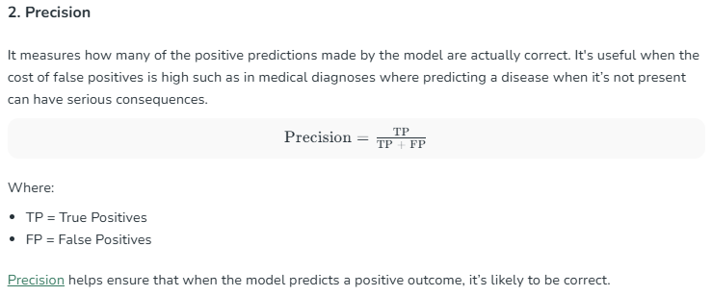
CLASSIFICATION METRICS

Slide 71
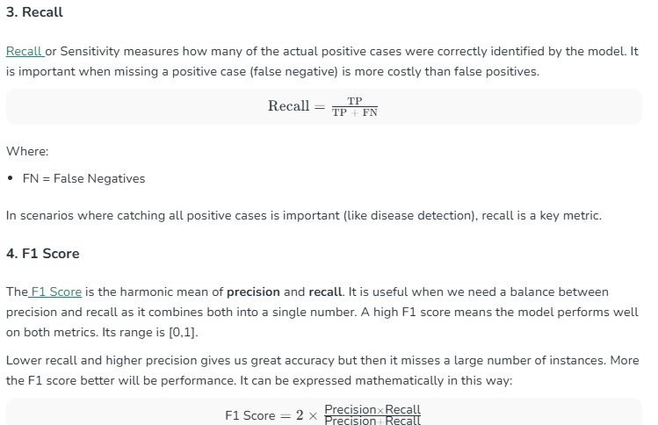

Slide 72
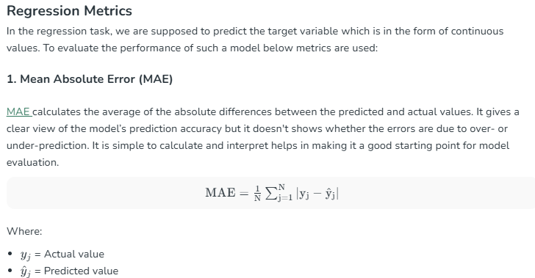

Slide 73
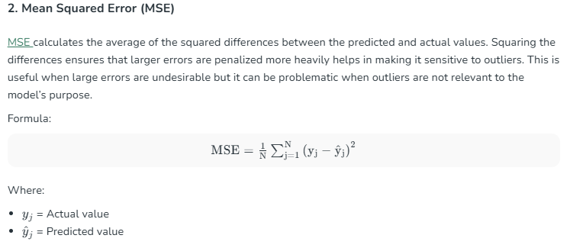

Slide 74
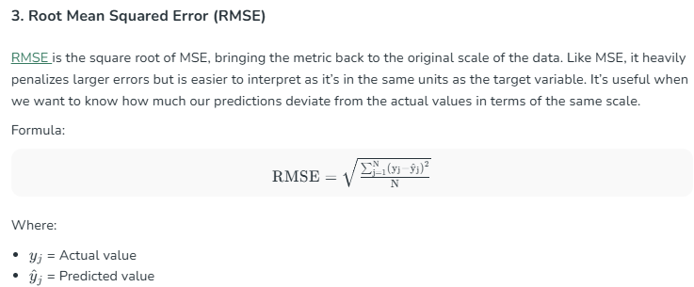

Slide 75
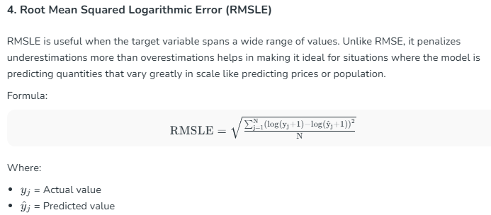

Slide 76
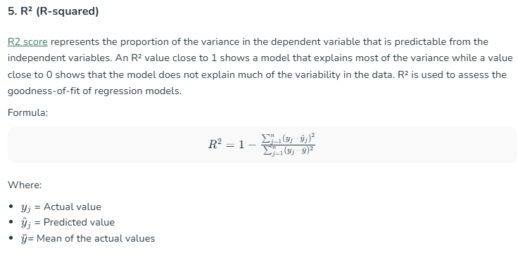

Slide 77
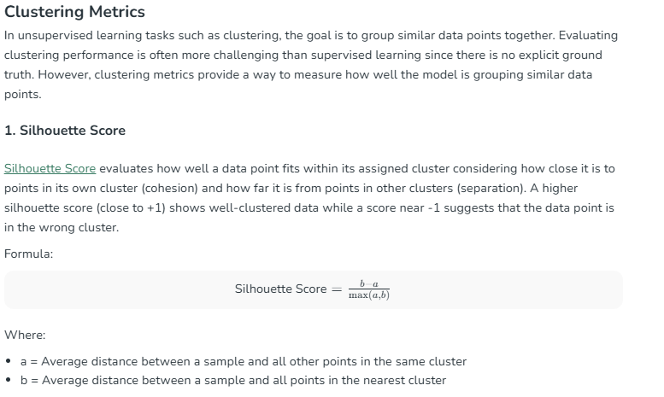

Slide 78
